Slide 1


HISTORY OF JAVA
CREATION OF JAVA
DEVELOPMENT OF JAVA
DIFFERENCE BETWEEN JAVA AND OTHER
PROGRAMMING LANGUAGES
PREPARED BY SALAYDINOV ADKHAM AND OTABAEV OTABEK

Slide 2



1. Creation of Java
Home : Sun Microsystems (Oracle Corporation).
Author : James Gosling.
Objective : To prepare simple electronic consumer goods.
Project : Green (First name of Java)
First Version : JDK 1.0 (1996, Jan-23)
Used Version : Some org JDK5.0, Some other JAVA 6, JAVA 7

Slide 3
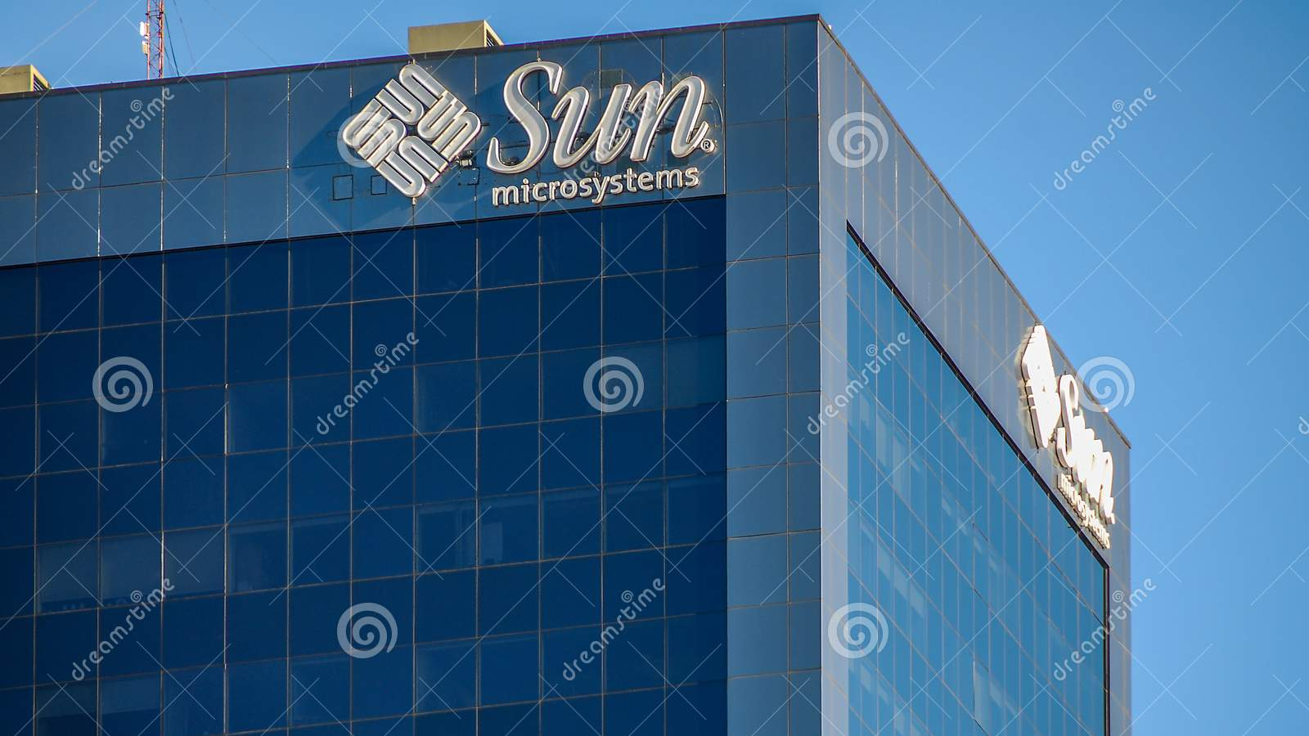
Sun Microsystems, Inc. (Sun for short) was an American technology
company that sold computers, computer components, software, and
information technology services and created the Java programming
language, the Solaris operating system, ZFS, the Network File System (NFS),
and SPARC microprocessors.
1991-year Sun Microsystems wanted to create a new software language
for simple electronic consumer devices.

Slide 4
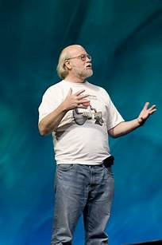
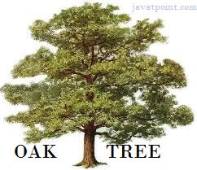
James Gosling, Mike Sheridan, and Patrick Naughton
initiated the Java language project in June 1991.
The small team of sun engineers called
Green Teams.
Firstly, project was called "Greentalk" by James Gosling, and the file extension was .gt
After that, it was called Oak and was developed as a part of the Green project.
In 1995, Oak was renamed as "Java" because it was already a trademark by Oak Technologies.
The suggested words were "dynamic", "revolutionary", "Silk", "jolt", "DNA", etc.
Since Java was so unique, most of the team members preferred Java than other names.

Slide 5



II. DEVELOPMENT OF JAVA by sun microsystems
JDK 1.0
Oak
January 1996
JDK 1.1
February 1997
J2SE 1.2
Playground
December 1998

Slide 6
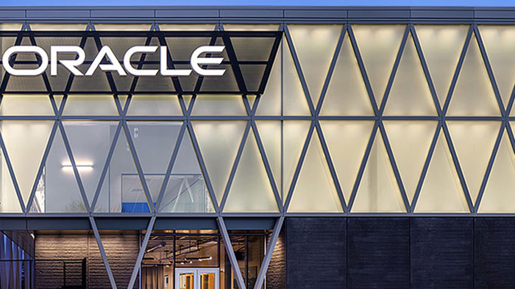
Developed by
Java SE 16
March, 16th 2021
Java SE 17
Java SE 18
March, 22nd 2022
September, 14th 2021
Java SE 16
March, 16th 2021
Java SE 17
Java SE 18
March, 22nd 2022
September, 14th 2021

Slide 7

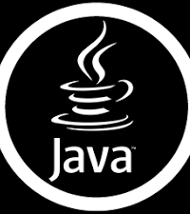
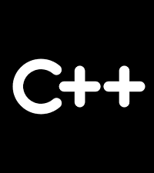
Differences
JAVA is dynamic programming language
C++ are static programming language
Pre-Processor is not required in Java
Pre-Processor is required in C++
JAVA is platform Independent programming language
C++ are platform dependent programming language
Pointers are not existed in Java
Pointers are existed in C++
Destructors are not required in JAVA
Destructors are required in C++
JAVA is following only call by value parameter passing mechanism
C++ is following Call By Value and Call by reference parameter passing mechanisms

Slide 8

Java Features
Simple
Object Oriented
Platform independent
Arch Neutral
Portable
Robust
Secure
Dynamic
Distrubuted
Interpretive
High Performance

Slide 9

THE USE OF JAVA
Mobile aplication
Desktop aplication
Web application
Game development
Big data processing
IoT applications

Slide 10
References:
www.codecademy.com
www.codejava.net
www.javatpoint.com
en.wikipedia.org
www.udemy.com
www.oracle.com

Slide 11
THANK YOU FOR
ATTENTION

